Slide 1

FlutterTube: Revolutionizing Mobile Learning
Presented by the Innovators Team, led by [Your Name], FlutterTube is a groundbreaking project addressing the challenge of Open Innovation in mobile app development.

Slide 2

Bridging the Gap in Mobile Development Learning
The Problem: Learning Curve for Beginners
New mobile developers often face significant hurdles. Understanding UI structure, mastering navigation flows, and implementing media-rich layouts in Flutter can be overwhelming without practical examples.
Our Solution: A Real-World Learning Platform
FlutterTube is a YouTube-inspired application designed to demystify these complexities. It offers a tangible, hands-on project to help beginners grasp core Flutter concepts in a practical context.

Slide 3
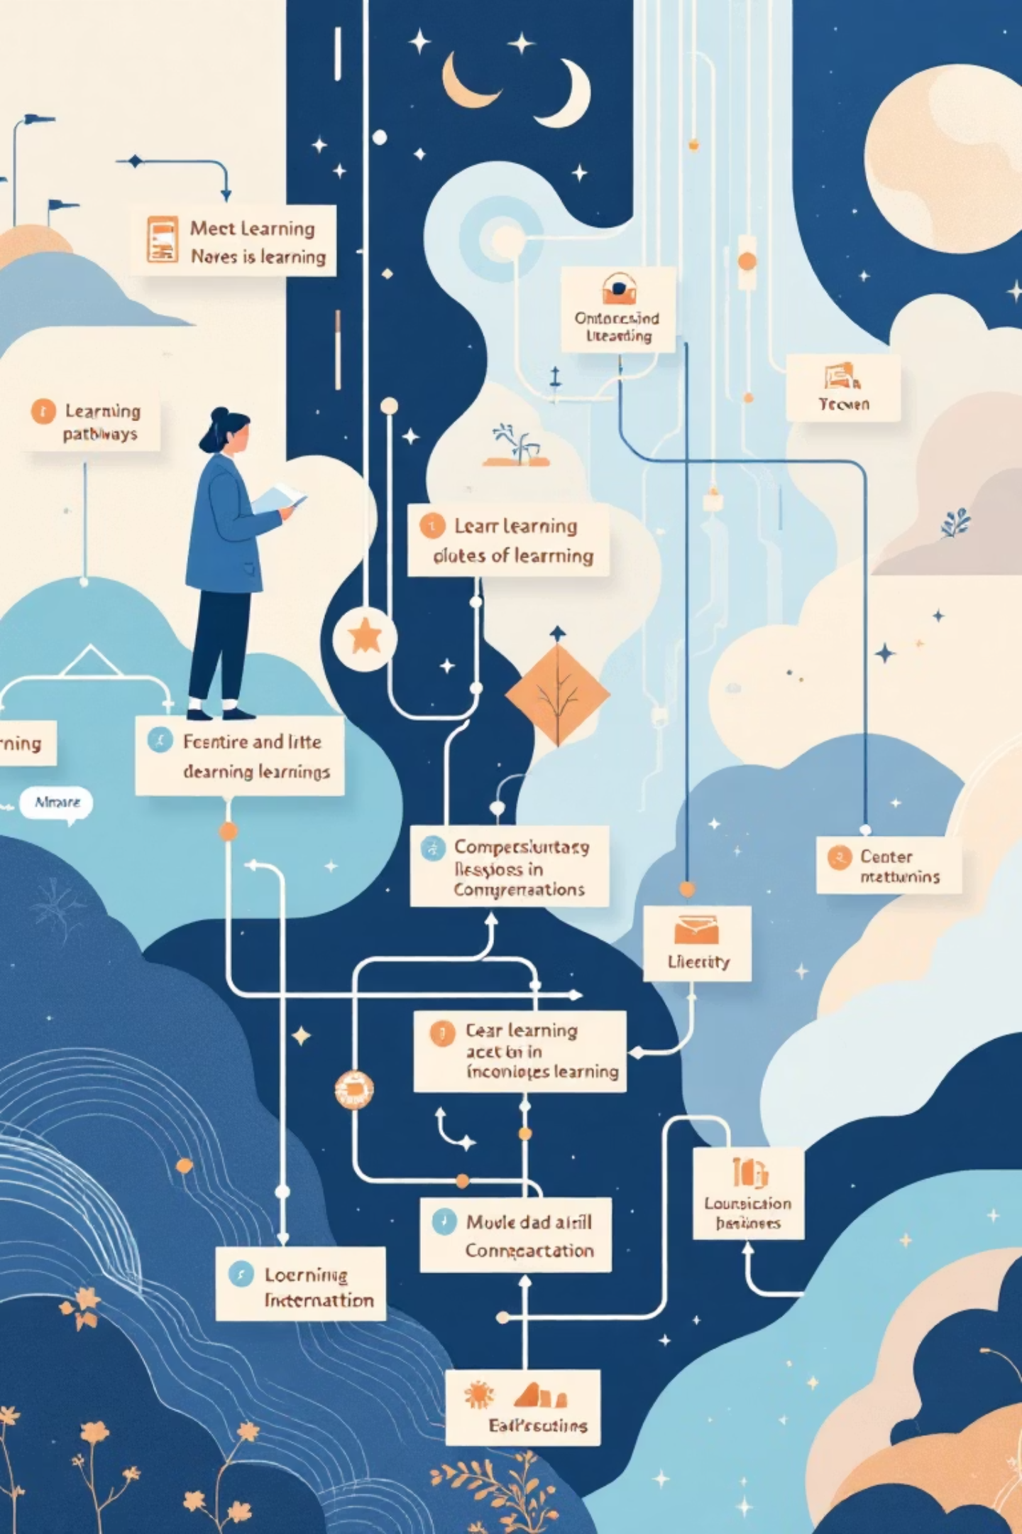



Why FlutterTube Stands Out
Learning-Focused Design
Unlike traditional apps, FlutterTube prioritizes educational implementation, ensuring every feature is a clear learning opportunity.
Simplified & Clean UI
Our interface is intentionally streamlined, removing unnecessary clutter to highlight fundamental UI principles and best practices.
Beginner-Friendly Structure
The project is organized to be easily digestible for new developers, offering a clear path from concept to execution.
FlutterTube is not just another app; it's a meticulously crafted learning tool designed to empower aspiring Flutter developers.

Slide 4

Empowering Developers with Practical Experience
Hands-On Flutter Experience
Gain direct experience building with Flutter, from widget trees to state management.
Real-World UI Patterns
Understand how common app UI patterns, like video listings and detail screens, are constructed in Flutter.
Grasp App Architecture
Learn about fundamental mobile application architecture by exploring a structured and scalable project.

Slide 5


Core Features of FlutterTube
Video Listing Interface
Thumbnail-Based Display
A dynamic display of video content, mimicking a popular streaming service layout.
Engaging visual presentation of videos using high-quality thumbnails.
Smooth Screen Navigation
Responsive UI Design
Seamless transitions and intuitive flow between different sections of the app.
Built with Flutter widgets to ensure a flexible and adaptive user interface across various Android devices.

Slide 6

The Power of Google Technologies
Flutter SDK
Dart Programming Language
The primary framework for building beautiful, natively compiled applications from a single codebase.
Google's client-optimized language for fast apps on any platform, powering Flutter.
Android SDK
Material Design Components
Essential tools and APIs for developing, debugging, and testing Android applications.
A comprehensive set of widgets that implement Google's Material Design guidelines for a consistent and intuitive user experience.

Slide 7

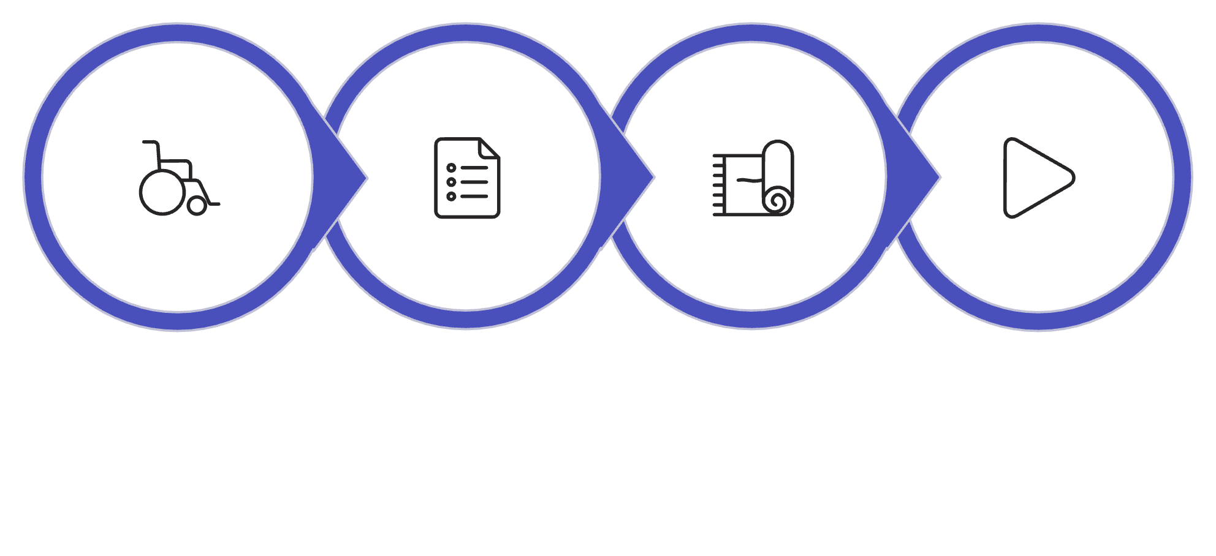
FlutterTube User Flow
Open App
Video List
Select Video
Video Details
This streamlined process ensures a clear and engaging user experience, from discovery to content consumption, guiding new developers through fundamental interaction patterns.

Slide 8
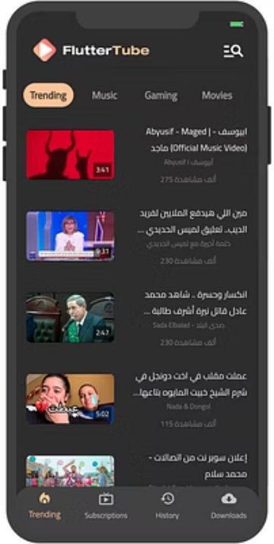
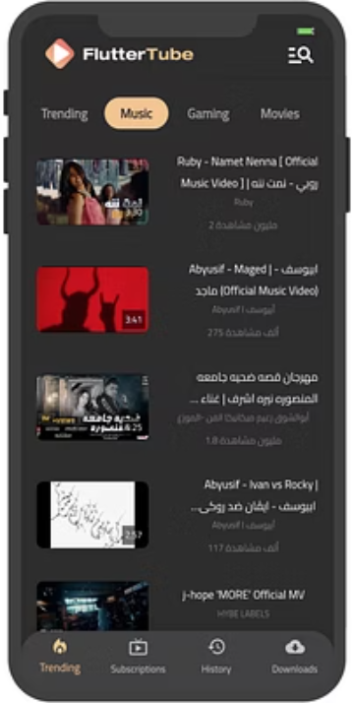
Design & Structure: The Visual Blueprint
The wireframes and mock diagrams illustrate the intuitive layout and navigation FlutterTube provides, crucial for a seamless learning experience.
These initial designs showcase the clean and purposeful structure that underpins FlutterTube's effectiveness as a learning tool.

Slide 9
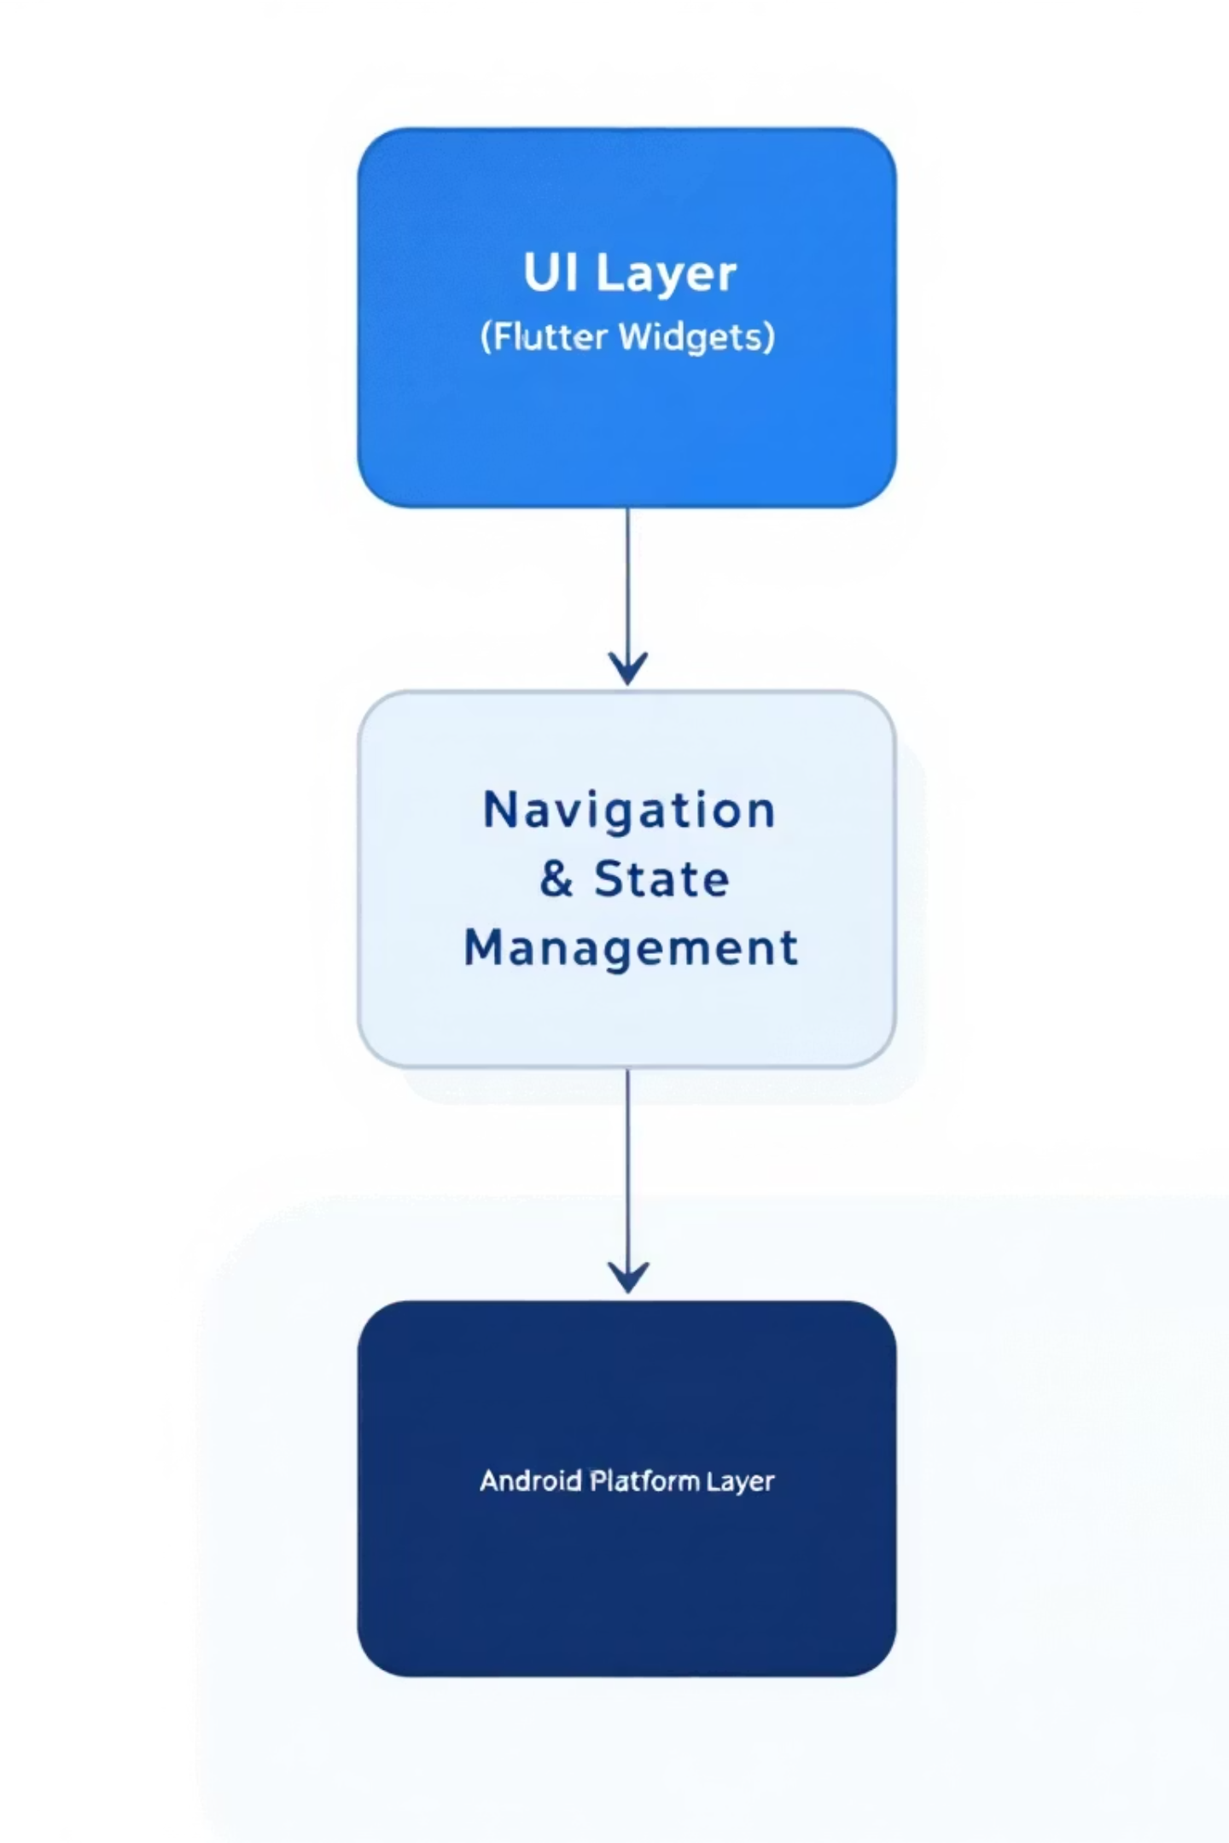
Under the Hood: FlutterTube's Architecture
01
02
UI Layer (Flutter Widgets)
Navigation & State Management
The visual representation and interaction elements, built entirely with Flutter's rich widget catalog.
Handles the flow between screens and manages the application's data and user interface states.
03
Android Platform Layer
Interacts with native Android features and services, ensuring smooth performance and integration.
This layered architecture provides a clear, maintainable, and scalable foundation for mobile app development.

Slide 10
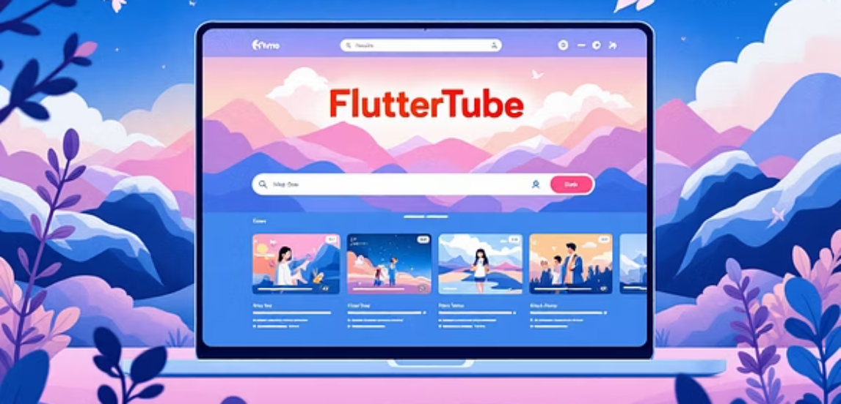
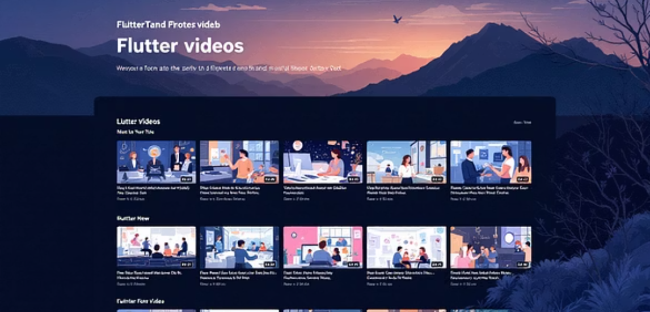
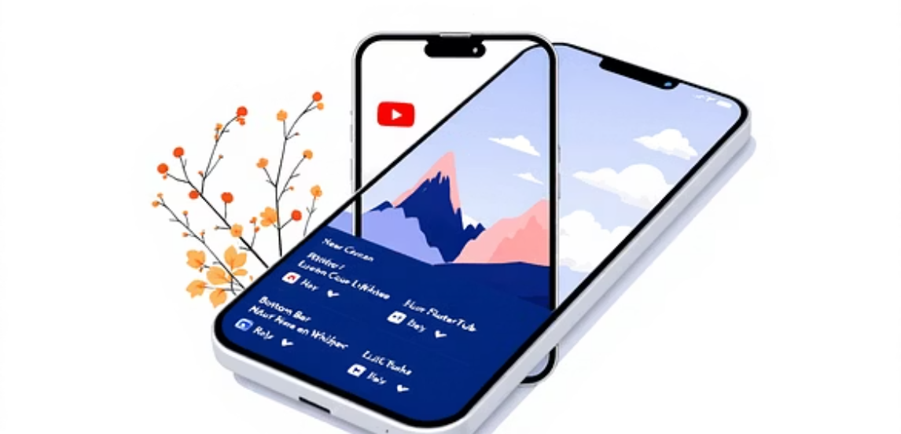
FlutterTube: The Road Ahead
1
2
3
User Authentication
YouTube API Integration
Video Playback
Implementing secure login and user profile management.
Connecting to real video data for an authentic streaming experience.
Full-featured video player for immersive content consumption.
4
5
Engagement Features
iOS Platform Support
Adding likes, comments, and subscription functionalities.
Expanding FlutterTube to reach Apple device users, demonstrating cross-platform capability.

